Slide 1

Crime record management system
PRESENTED BY,
Jebitha W
Class No. PSCP223415
Reg No. 20223112506117
II M. Sc computer Science

Slide 2
Abstract
The Crime Record Management System is a comprehensive software application developed using C# .NET and SQL Server, designed to streamline the management and organization of crime-related data. The system caters to two primary types of users: Crime Record Managers and Police Stations.
Crime Record Managers have the capability to log in to the system, and their role primarily involves the administration of police station information. They can add, view, update, and delete details related to various police stations. Additionally, Crime Record Managers can access and oversee vital information regarding missing persons, vehicle thefts, and common thefts of missing belongings.
On the other hand, Police Stations are required to register with the system and subsequently log in to access their functionalities. They can report and add specific crime details such as missing persons, vehicle theft., and thefts of missing belongings. This information is crucial for maintaining accurate and up-to-date records at the police station level.

Slide 3
INTRODUCTION:
In an era where the management and organization of crime-related data are of utmost importance, the Crime Record Management System emerges as a vital solution. Developed using the powerful C# .NET framework and supported by the reliability of SQL Server, this project aims to revolutionize the way crime-related information is handled.
This software system caters to the needs of two distinct user roles: Crime Record Managers and Police Stations. By facilitating a seamless and efficient interaction between these two entities, the system seeks to enhance the overall management of criminal activities and investigations.
This project not only simplifies the process of registering and accessing police station data but also empowers Crime Record Managers with the ability to oversee, update, and maintain vital information about missing persons, vehicle thefts, and common thefts of missing belongings. Likewise, it equips Police Stations with the means to swiftly report and document crime details, ensuring that records are always up-to-date and accurate.

Slide 4
EXISTING SYSTEM
In the existing system people who want to file a complaint must go to the police station all by themselves which is time consuming. Police people usually maintain records manually which is again time consuming and it difficult to manage those records. Major issues are: Time consuming paper work needed Loss of records

Slide 5
PROPOSED SYSTEM:
PROPOSED SYSTEM:
The manual system has some drawbacks which can be overcome by using our web based software “Crime Management System” .
Police need not have to maintain records manually since our software maintains all the records with centralized database.
In these work the reduce Time consuming and no paper work needed.
There is no loss of records and it is centralised database management.

Slide 6
User Roles:
Crime Record Manager
Police station

Slide 7
Key features of crime record manager:
Secure login for crime record manager
Police station Management : Add, vie, update and delete police stations.
Crime Management : View the complete crime details.

Slide 8
Key features for police station:
Secure login for police station.
Crime Management : Add crime details such as, Missing persons details , vehicle theft details ,common theft of missing things.

Slide 9
TECHNOLOGIES USED :
IDE : Visual Studio 2022
Framework : . NET
Front-end : C#
Back-end : C#
Database : SQL server 2019
Documentation Tool : Microsoft Word 2021
Presentation Tool : Microsoft PowerPoint 2021

Slide 10
DATAFLOW DIAGRAM

Slide 11
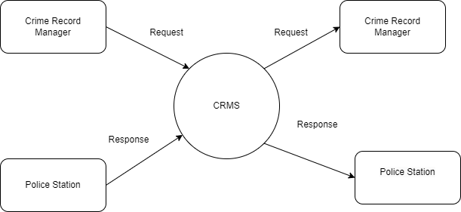
Context level

Slide 12
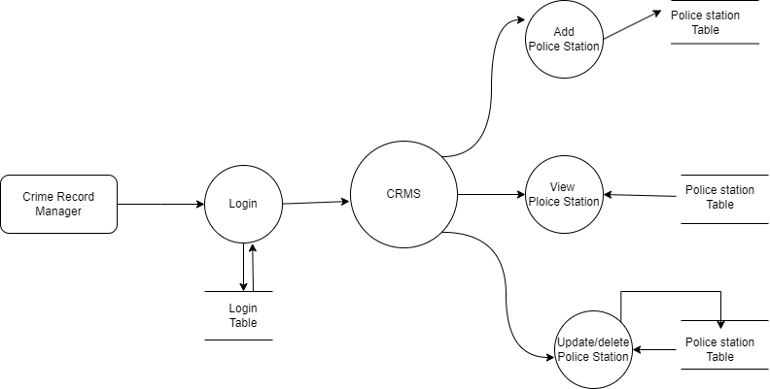
Crime record manager level

Slide 13
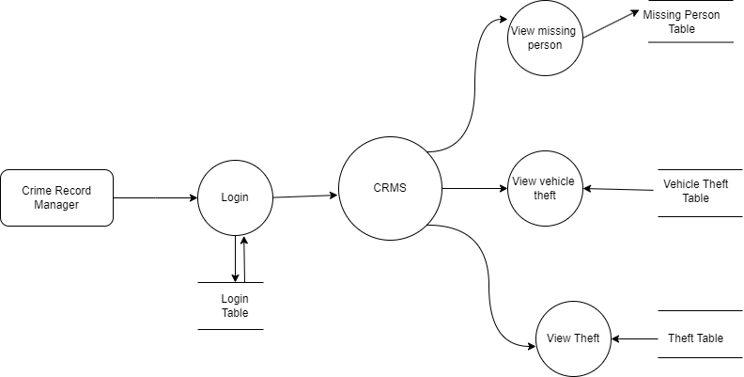
Crime record manager level 2

Slide 14

Police station level

Slide 15
Screen shots

Slide 16

Home page

Slide 17
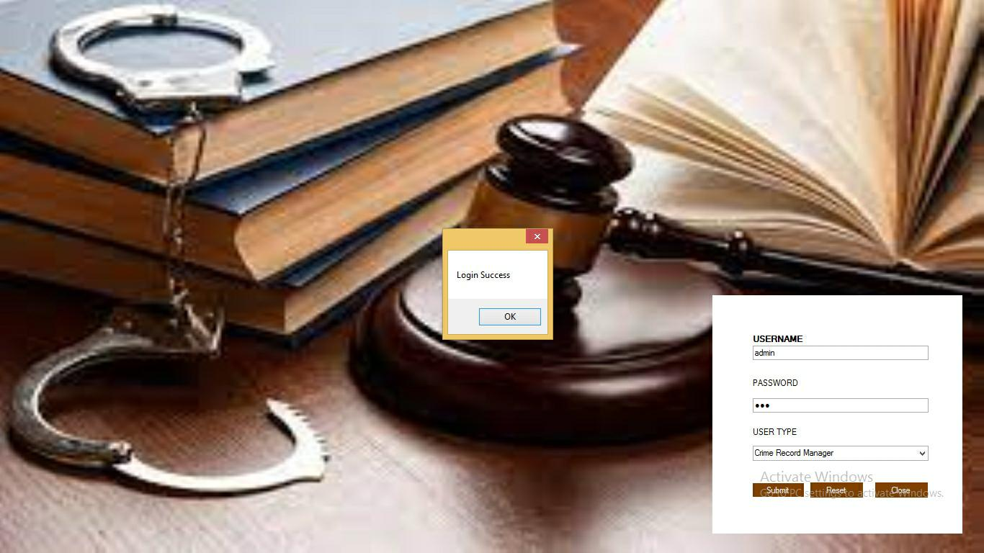
Login page

Slide 18
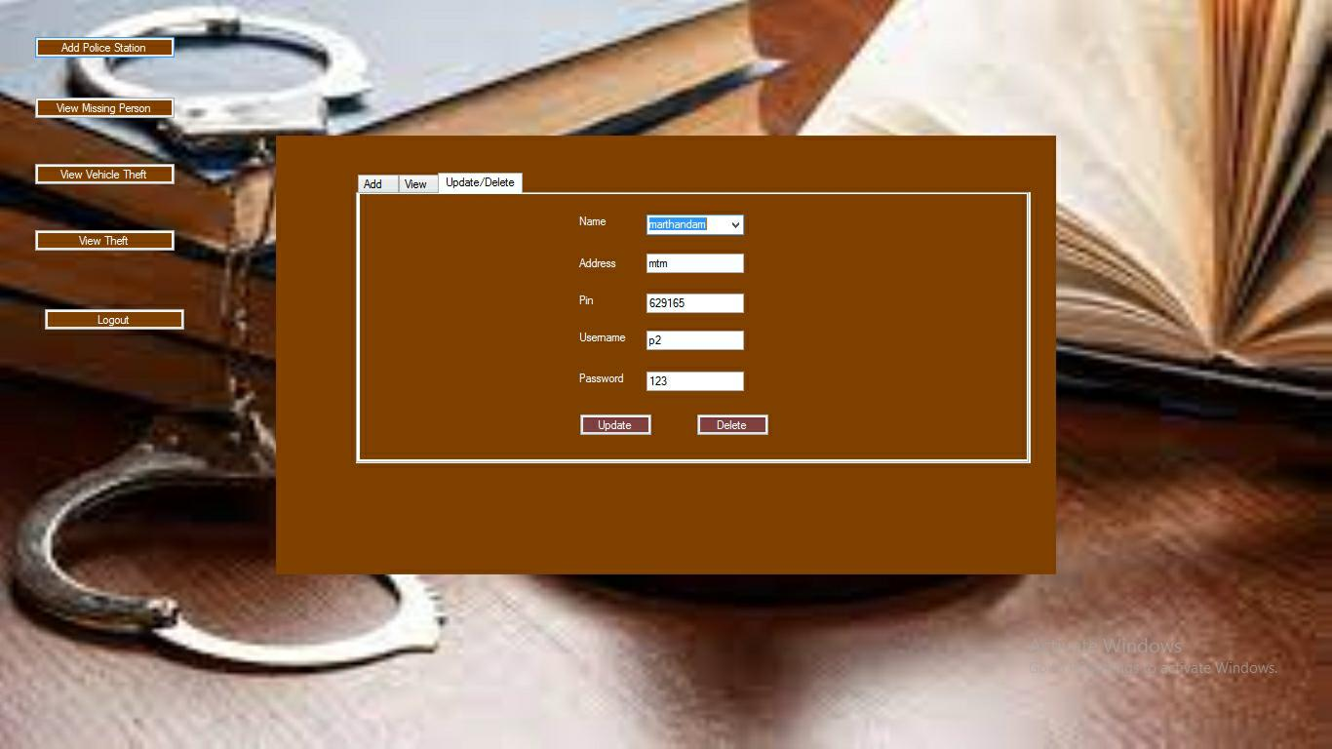
Add police station

Slide 19
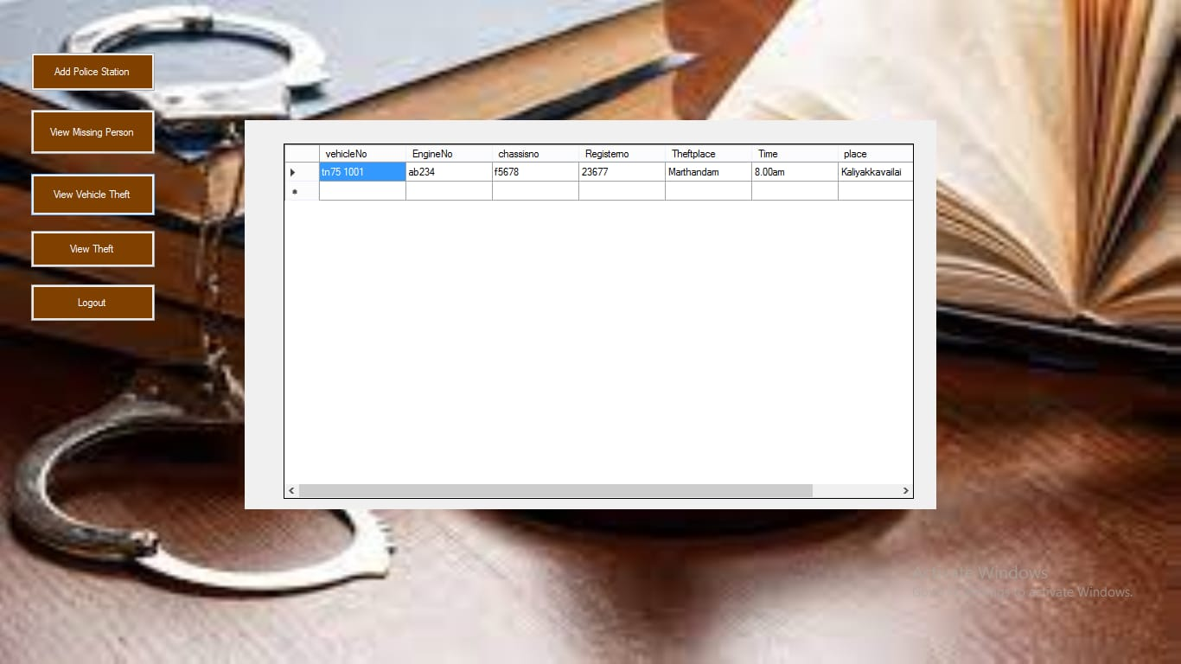
View vehicle theft

Slide 20
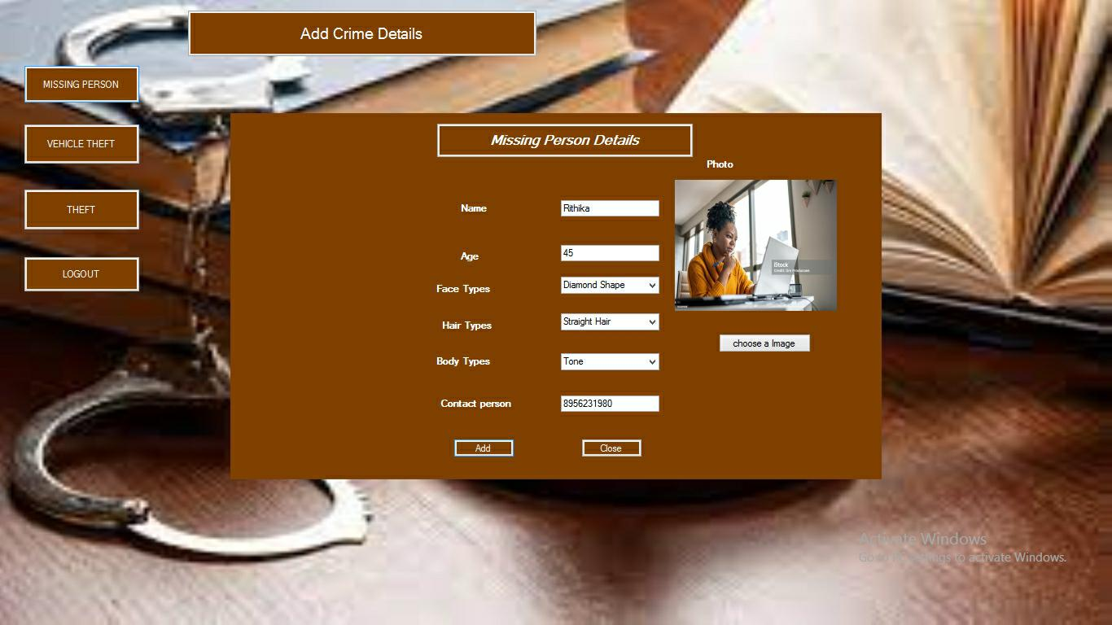
Police station
Missing persons details

Slide 21
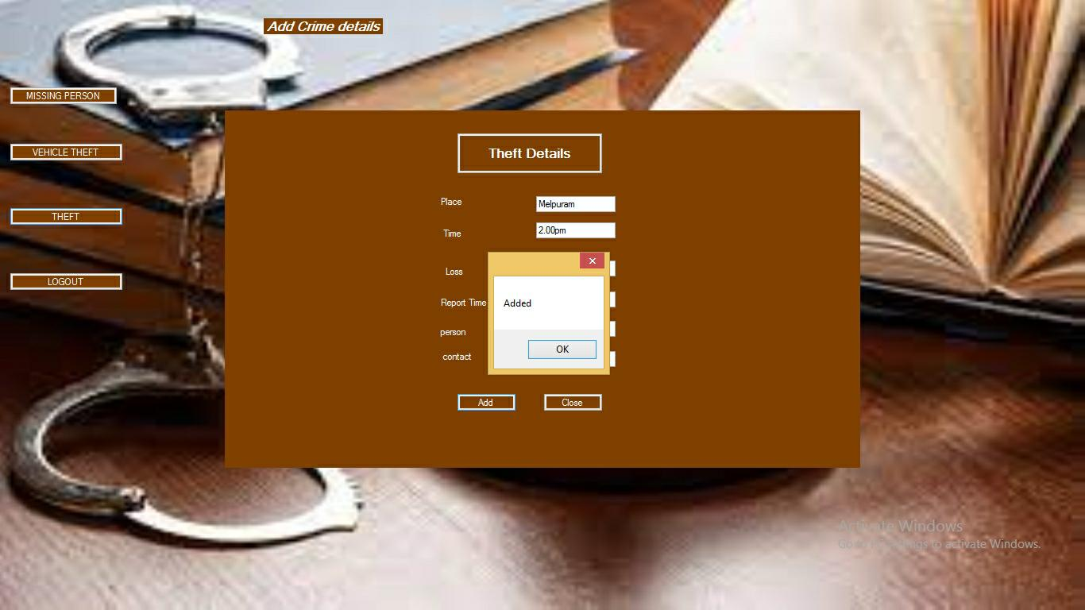
Add Vehicle Theft

Slide 22
Conclusion
In conclusion, the "Crime Record Management System" represents a pivotal tool in the realm of law enforcement, offering a comprehensive solution for the efficient management of crime-related data. With a robust feature set encompassing user management, data entry, reporting, and security measures, the system equips law enforcement agencies with the means to enhance public safety, investigate crimes, and analyze trends. Its ability to support real-time updates and data exchange with external systems underscores its significance in the ever-evolving landscape of law enforcement. While the project presents substantial benefits, ongoing maintenance, regular updates, and a commitment to data security and user training will be crucial to ensuring the system's continued effectiveness and relevance in the service of safeguarding communities and maintaining the highest standards of public safety.

Slide 23
Future work
The "Crime Record Management System" serves as a crucial tool for law enforcement agencies in the efficient management of crime-related data. To ensure its continued effectiveness and relevance, several future enhancements can be considered. One possible avenue for improvement is the integration of advanced analytics and artificial intelligence (AI) capabilities. By leveraging machine learning algorithms, the system can provide predictive analytics to help identify emerging crime trends and potential hotspots. This proactive approach can assist law enforcement agencies in deploying resources more effectively and preventing criminal activities.In addition, enhancing the system's mobility and support for field officers could greatly benefit its usability. Mobile applications that enable officers to input data, access information, and receive real-time updates while in the field can expedite investigations and improve response times.

Slide 24
THANK YOU

